Slide 1

The Brain
How thinking work
- First read the manual -

Slide 2
Feedback/Ideas
After each slide, put a practical use
Apply PurposeObjectiveWhy

Slide 3
The Brain – hardware

Slide 4
Chronologic
Birth
Grow (up)
Learn
Optimize
Birth
Grow
Learn
Optimize

Slide 5
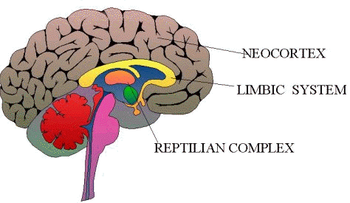
Brain - functions
Reptilian Complex
Basic survival
Fight/Flee/Freeze
Organs (breathe, heartbeat, ...)
Limbic System
Relationships
Cortex
Memory
Unconsciousness
Thinking
Neocortex
Thinking about past/future
Thinking about thinking
Self-awareness
http://en.wikipedia.org/wiki/Human_brain

Slide 6
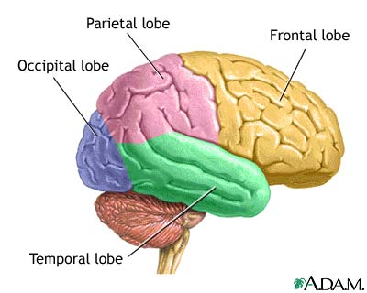
Brain - cortex cerebri
Parietal lobe
Sense/touch
Coordination
Frontal lobe
Conscious
Long term memories
Occipital lobe
Visual
Temporal lobe
Visual memories
Processing sensory input
Language comprehension
New memories
http://en.wikipedia.org/wiki/Cerebral_cortex

Slide 7
The brain – operating system

Slide 8
Brain - chronologic
Reptilian Complex
Active around week 20 before birth
Limbic System
Activated during birth
Cortex
Activated around 2 years
Neocortex
Activated around puberty
http://en.wikipedia.org/wiki/Human_brain

Slide 9
Brain – left and right
LEFT BRAIN FUNCTIONS
uses logic
detail oriented
facts rule
words and language
present and past
math and science
can comprehend
knowing
acknowledges
order/pattern perception
knows object name
reality based
forms strategies
practical
safe
RIGHT BRAIN FUNCTIONS
uses feeling
"big picture" oriented
imagination rules
symbols and images
present and future
philosophy & religion
can "get it" (i.e. meaning)
believes
appreciates
spatial perception
knows object function
fantasy based
presents possibilities
impetuous
risk taking
http://www.viewzone.com/bicam.html

Slide 10
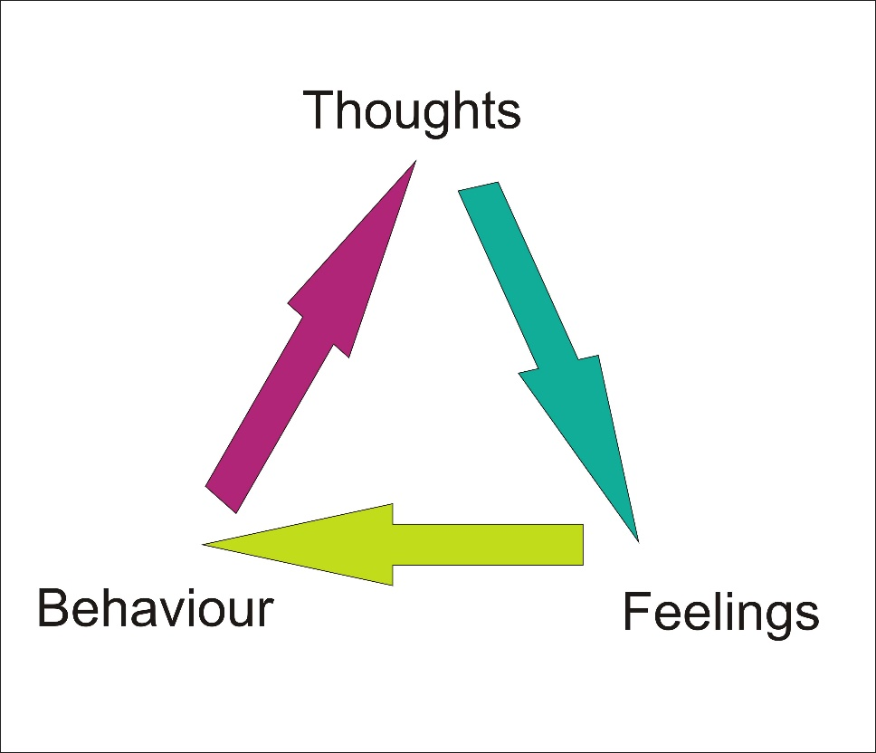
Thoughs rule the world
Your ‘mind’ us naturally tuned to the negative…

Slide 11
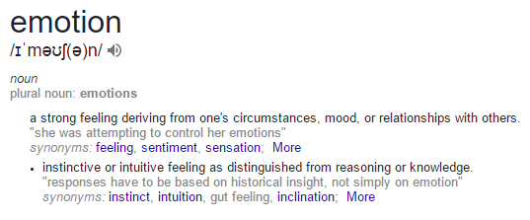
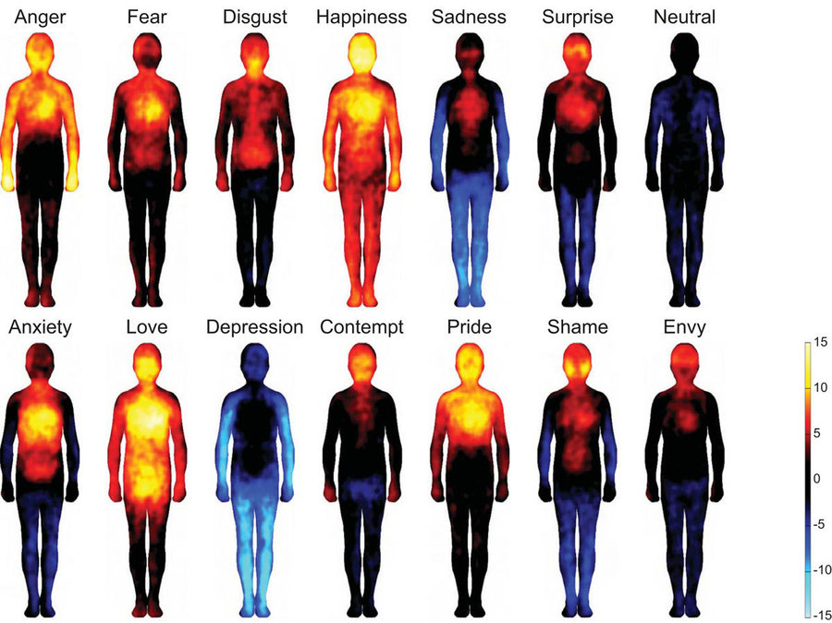
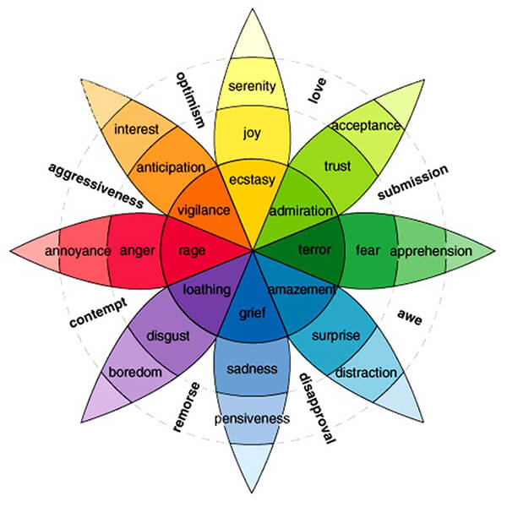
Emotions – what are they?
What is the purpose of emotions? For self or others? Are emotions (mainly) triggered by thought process or is there a ‘magic’ button (say: event). Is love a emotion?

Slide 12
Personality

Slide 13
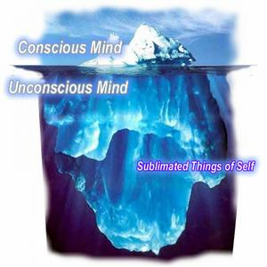
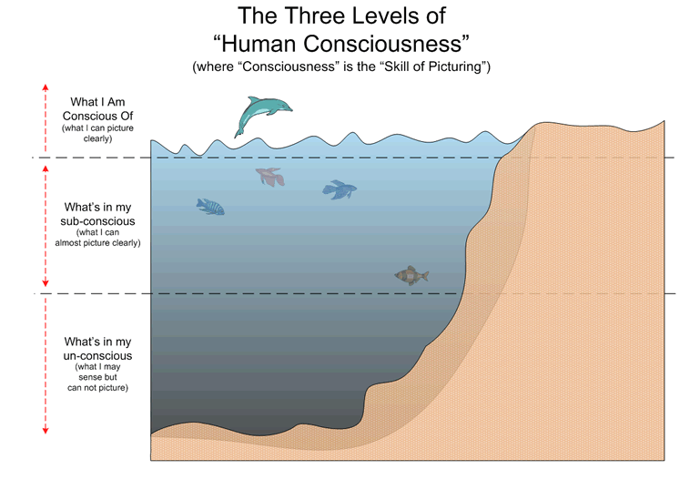
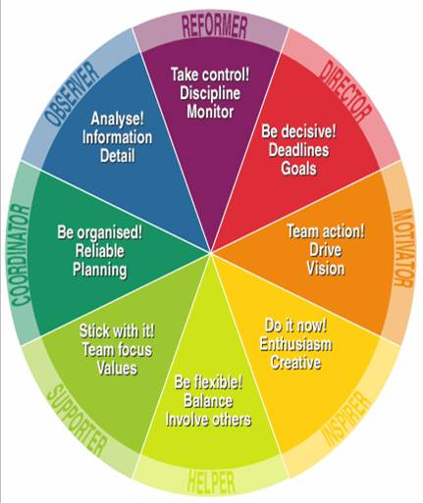
Thinking – consciously – unconscious - personality

Slide 14
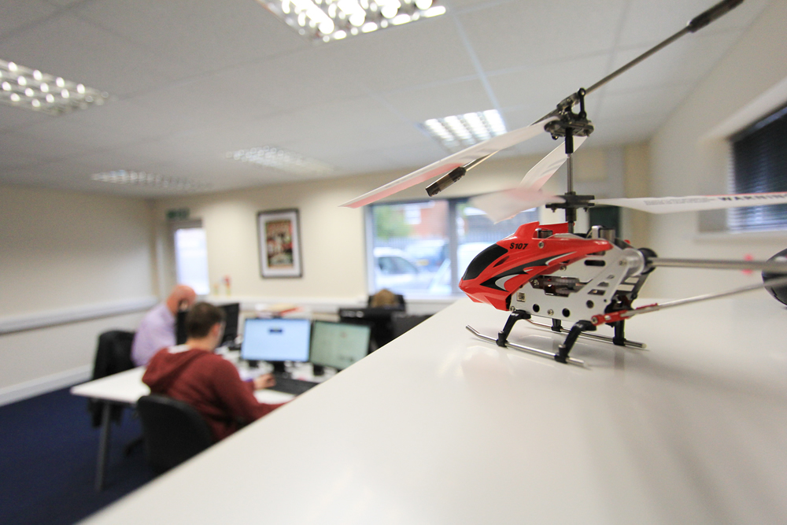
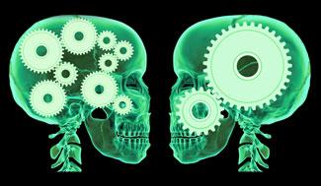
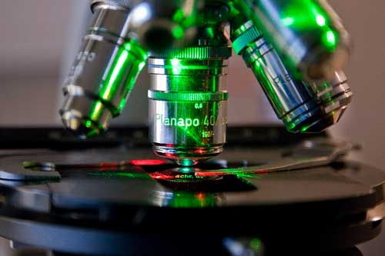
Who are you? What defines you – are you a specialist or a generalist, or in the middle?
Why?
The trouble with generalists is that they know less en less about more and more, they eventually know nothing about everything
The trouble with specialists is that they know more and more about less and less, they eventually know everything about nothing
How?

Slide 15
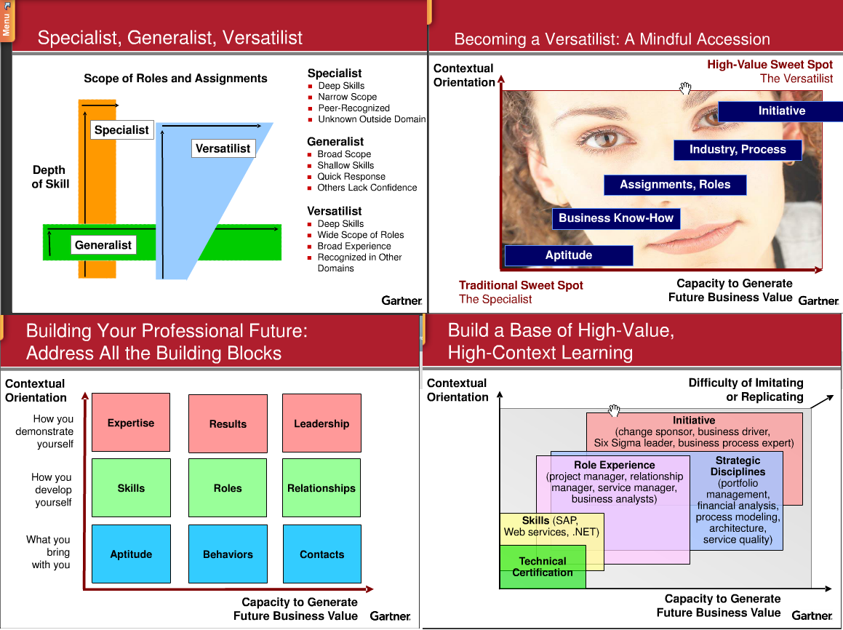
Specialist Generalist, Versatilist

Slide 16
Self or Others?
Todo: Blame orientation, internal, external: process&self&othrts, order, authority: complements, angry, shit hits fan, drive neg from self or other, who are they trying to please, me real or they real, how do they enter a room

Slide 17
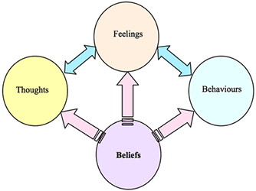
Personality (internal): REBT Rational Emotive Behavior
Core ineffective thoughts:
Disaster-thinking
Perfectionism
Love-junk
Normativism
Low-frustration tolerants
Triggered by reptilian brain, make cascade effect in unconscious thoughts…
http://en.wikipedia.org/wiki/Rational_Emotive_Therapy
Notes:
http://www.leren.nl/cursus/persoonlijke-effectiviteit/ret/ineffectieve-gedachten.html
Rampdenken: als er iets gebeurt, dan staat dat gelijk aan een ramp
“als ............. gebeurt, dan is dat een ramp”
“als ............. gebeurt, dan is dat verschrikkelijk”
“als ............. gebeurt, dan overleef ik dat niet”
Perfectionisme: alles wat ik doe, moet helemaal perfect zijn
“ik MOET altijd alles perfect doen”
“als ik het niet goed doe, dan ben ik een enorme loser/sukkel/nitwit...”
“als ik het niet goed doe, dan vergeef ik mezelf dat nooit!”
Love-junk: verslaafd zijn aan de liefde van anderen
“Iedereen MOET mij aardig vinden”
“Als iemand mij niet aardig vindt, dan kan ik daar niet mee omgaan”
“Als mensen mij niet aardig vinden, dan blijft er niets van mij over”
Normativisme: iedereen moet zich aan mijn norm houden en de wereld moet volgens mijn norm in elkaar zitten
“Iedereen moet met 2 woorden spreken”
“Dieven zouden niet mogen bestaan”
“Alle docenten moeten alle studenten gelijk behandelen”
Lage frustratietolerantie (LFT): letterlijk: niet kunnen omgaan met je eigen frustraties. Dat lukt mij nooit, dat is veel te moeilijk, dat is onverdraaglijk, de wereld is tegen mij.
“Als.... gebeurt, dan kan ik dat niet verdragen”
“Iedereen gaat expres in de file staan om mij dwars te zitten”
“Deze tentamenstof is veel te veel, ik krijg het nooit onder de knie”

Slide 18
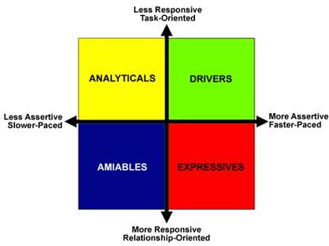
Social Styles
Analyticals need to be right
Orientation: Thinking
Growth Action: To Declare
Amiables need personal security
Orientation: Relationships
Growth Action: To Initiate
Drivers need results
Orientation: Action
Growth Action: To Listen
Expressives need personal improvements
Orientation: Spontaneity
Growth Action: To Check

Slide 19
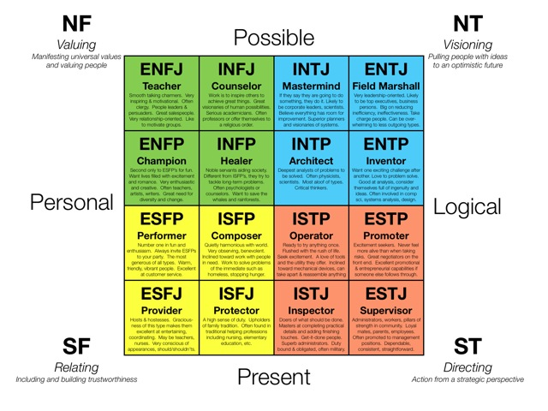
Myers Briggs Type Indicator

Slide 20
Behaviour

Slide 21
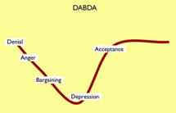
k Elisabeth Kubler-Ross
Denial
Anger
Bargaining
Depression
Acceptance

Slide 22
Thinking

Slide 23
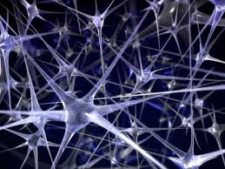
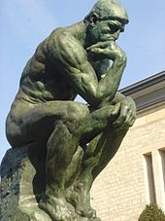
What is thinking? - Thought
The Thinker by Rodin (1840–1917), in the garden of the Musée Rodin
Synapsis – creating new connections in the brain.
take place only at a conscious level of awareness – we choose to think (or not to think, see ‘balance’-part)
http://en.wikipedia.org/wiki/Thought

Slide 24
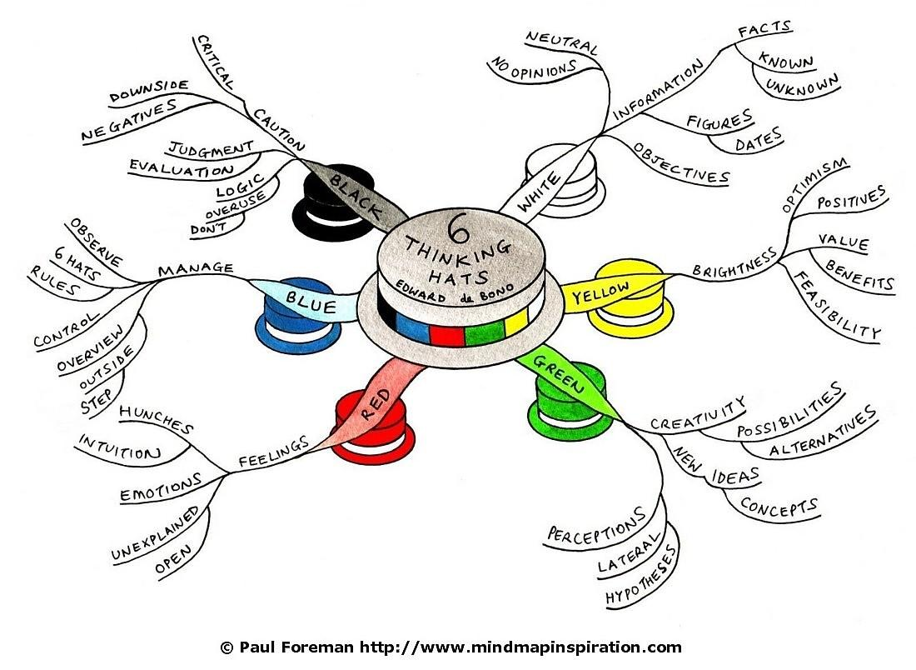
Thinking
White
Yellow
Green
Red
Blue
Black
http://en.wikipedia.org/wiki/Six_Thinking_Hats

Slide 25
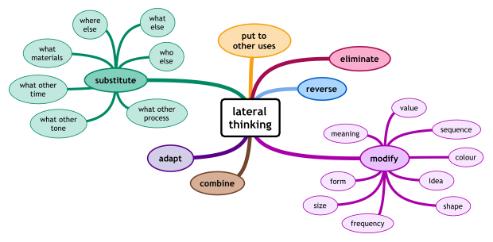

Lateral Thinking “We can not solve our problems with the same level of thinking that created them” . ― Albert Einstein
http://en.wikipedia.org/wiki/Lateral_thinking

Slide 26
Objections…
Don’t Want
Can’t
Don’t Know

Slide 27
Learning

Slide 28
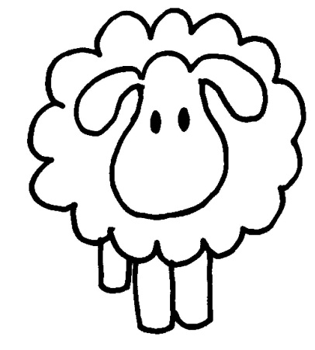
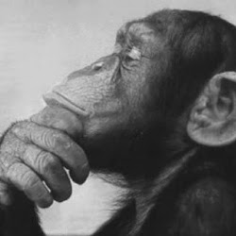
Learning
Observational Learning
Only left brain focused
Learning by watching others
Not focused on thinking
What, when (how)?
Associative Learning
Left and Right brain working together
Learning by doing
Focused on thinking, making connections
Why, how?
Notes:
http://www.leren.nl/cursus/persoonlijke-effectiviteit/ret/ineffectieve-gedachten.html
Rampdenken: als er iets gebeurt, dan staat dat gelijk aan een ramp
“als ............. gebeurt, dan is dat een ramp”
“als ............. gebeurt, dan is dat verschrikkelijk”
“als ............. gebeurt, dan overleef ik dat niet”
Perfectionisme: alles wat ik doe, moet helemaal perfect zijn
“ik MOET altijd alles perfect doen”
“als ik het niet goed doe, dan ben ik een enorme loser/sukkel/nitwit...”
“als ik het niet goed doe, dan vergeef ik mezelf dat nooit!”
Love-junk: verslaafd zijn aan de liefde van anderen
“Iedereen MOET mij aardig vinden”
“Als iemand mij niet aardig vindt, dan kan ik daar niet mee omgaan”
“Als mensen mij niet aardig vinden, dan blijft er niets van mij over”
Normativisme: iedereen moet zich aan mijn norm houden en de wereld moet volgens mijn norm in elkaar zitten
“Iedereen moet met 2 woorden spreken”
“Dieven zouden niet mogen bestaan”
“Alle docenten moeten alle studenten gelijk behandelen”
Lage frustratietolerantie (LFT): letterlijk: niet kunnen omgaan met je eigen frustraties. Dat lukt mij nooit, dat is veel te moeilijk, dat is onverdraaglijk, de wereld is tegen mij.
“Als.... gebeurt, dan kan ik dat niet verdragen”
“Iedereen gaat expres in de file staan om mij dwars te zitten”
“Deze tentamenstof is veel te veel, ik krijg het nooit onder de knie”

Slide 29
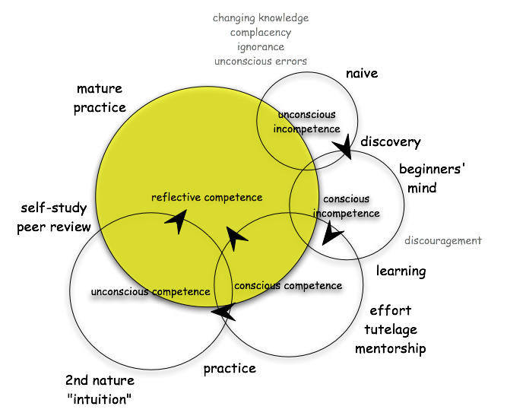
Learning Will Taylor’s conscious competence expanded model
 | competence | incompetence
conscious | 3 | 2
unconscious | 4 | 1
Notes:
http://www.leren.nl/cursus/persoonlijke-effectiviteit/ret/ineffectieve-gedachten.html
Rampdenken: als er iets gebeurt, dan staat dat gelijk aan een ramp
“als ............. gebeurt, dan is dat een ramp”
“als ............. gebeurt, dan is dat verschrikkelijk”
“als ............. gebeurt, dan overleef ik dat niet”
Perfectionisme: alles wat ik doe, moet helemaal perfect zijn
“ik MOET altijd alles perfect doen”
“als ik het niet goed doe, dan ben ik een enorme loser/sukkel/nitwit...”
“als ik het niet goed doe, dan vergeef ik mezelf dat nooit!”
Love-junk: verslaafd zijn aan de liefde van anderen
“Iedereen MOET mij aardig vinden”
“Als iemand mij niet aardig vindt, dan kan ik daar niet mee omgaan”
“Als mensen mij niet aardig vinden, dan blijft er niets van mij over”
Normativisme: iedereen moet zich aan mijn norm houden en de wereld moet volgens mijn norm in elkaar zitten
“Iedereen moet met 2 woorden spreken”
“Dieven zouden niet mogen bestaan”
“Alle docenten moeten alle studenten gelijk behandelen”
Lage frustratietolerantie (LFT): letterlijk: niet kunnen omgaan met je eigen frustraties. Dat lukt mij nooit, dat is veel te moeilijk, dat is onverdraaglijk, de wereld is tegen mij.
“Als.... gebeurt, dan kan ik dat niet verdragen”
“Iedereen gaat expres in de file staan om mij dwars te zitten”
“Deze tentamenstof is veel te veel, ik krijg het nooit onder de knie”

Slide 30
Neuro-linguistic programming (NLP)
Asserts a connection between the neurological processes ("neuro"), language ("linguistic"), and behavioural patterns learned through experience ("programming") that proponents speculate can be changed to achieve specific goals in life.
http://en.wikipedia.org/wiki/Neuro-linguistic_programming

Slide 31
Communication

Slide 32
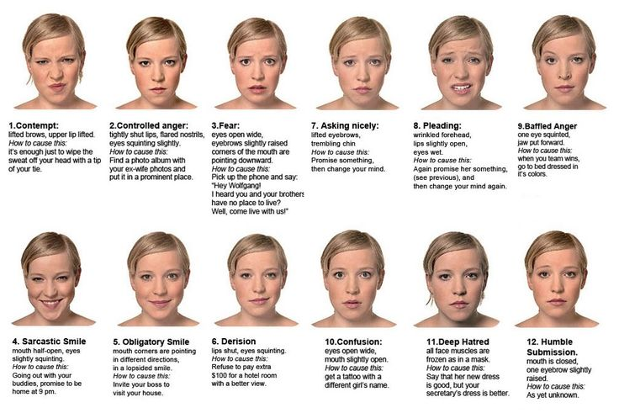
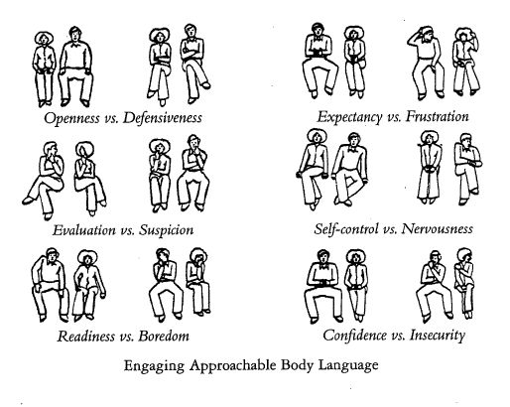
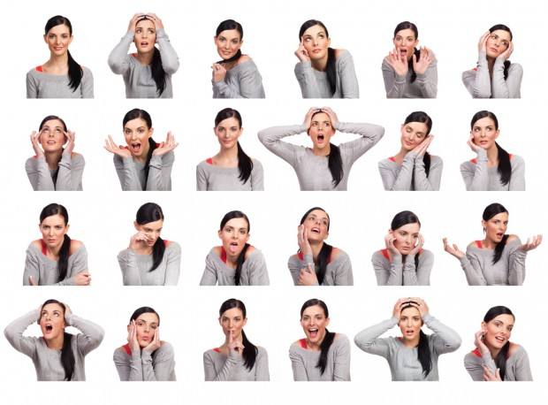
Body language | facial expressions | hands | eyes
Based on context, nationality, age, sex, relationship, trust, personal state, … (=highly complex)

Slide 33
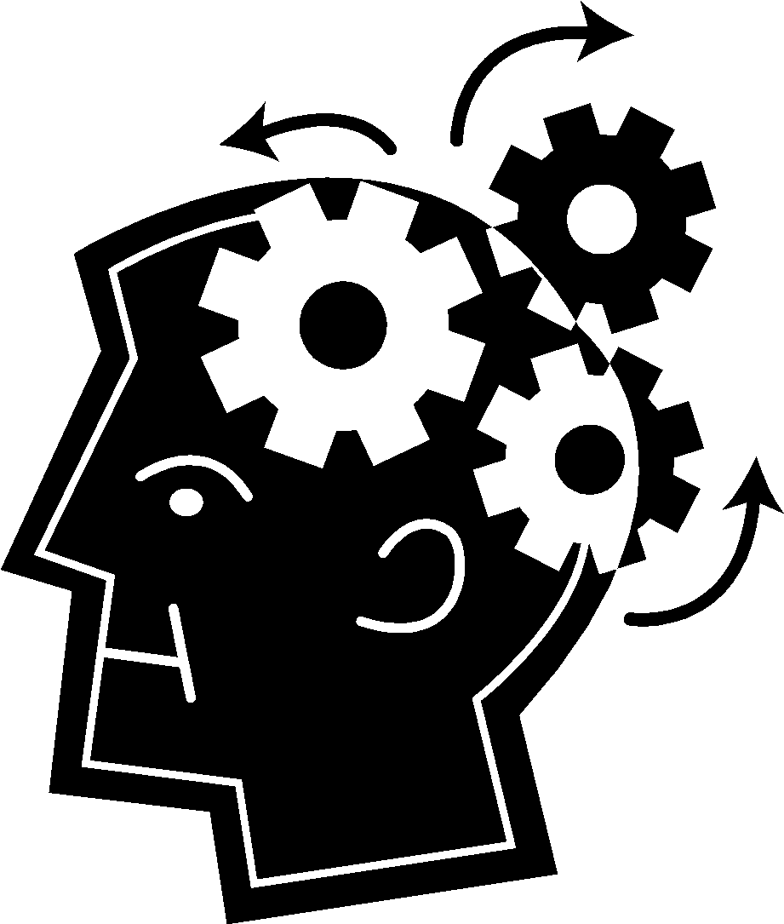
Listen with an open mind
Beliefs
Values
Values
Beliefs
Automatic
Thoughts
Automatic
Thoughts
Assumptions
Assumptions
Intentions
Intentions

Slide 34
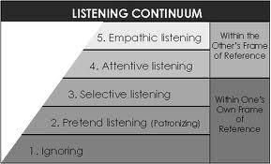
5 levels of listening

Slide 35
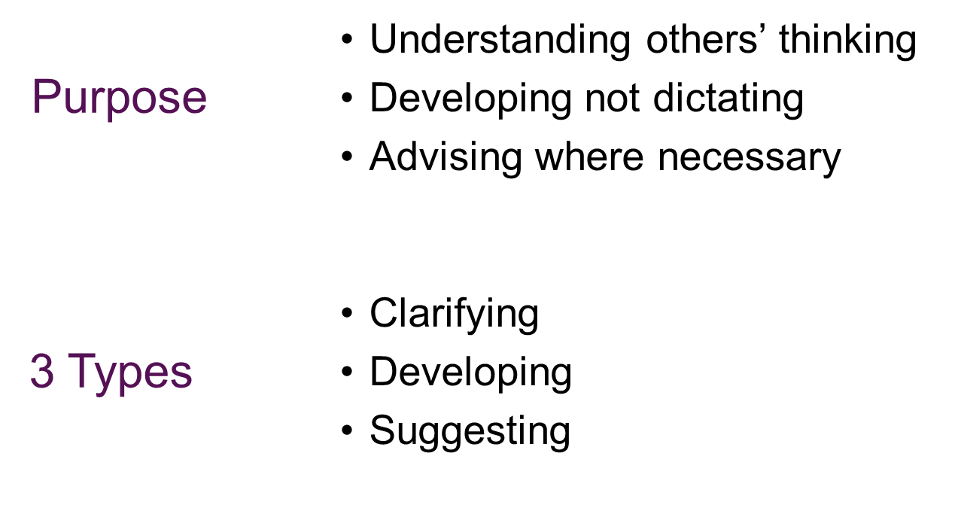
Asking (coaching) questions

Slide 36
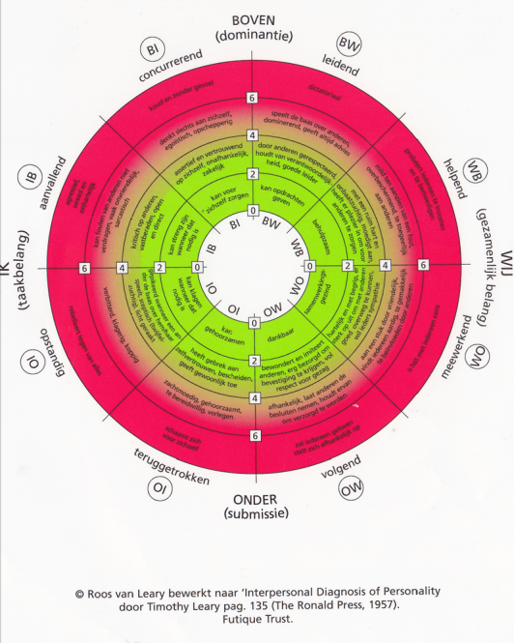
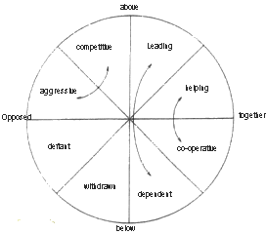
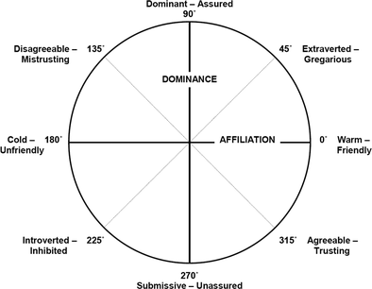
Communication: Leary’s Rose
@todo: http://www.testjegedrag.nl/tjg/zelftest/engels/index.htm

Slide 37
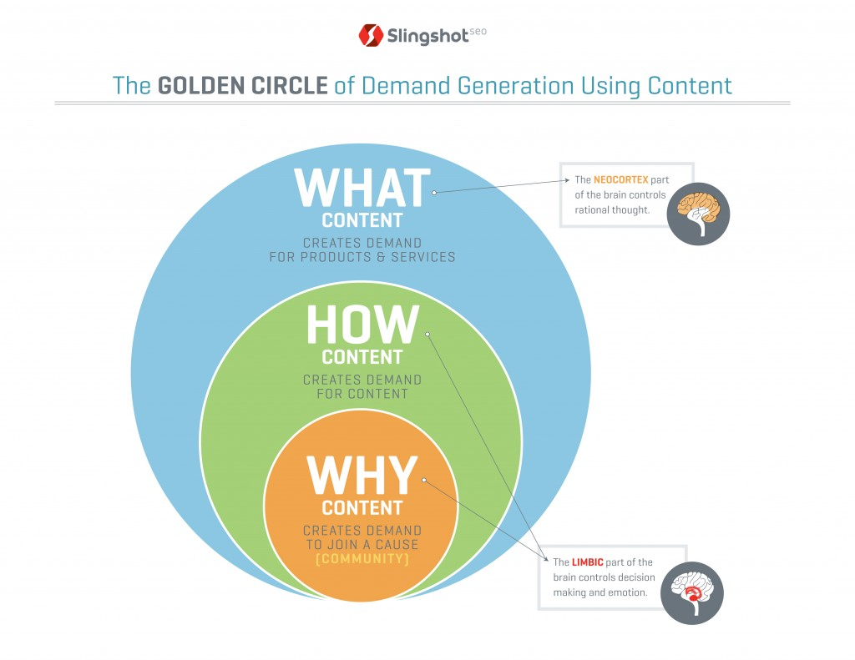
The Golden Circle – Simon Sinek
http://www.ted.com/talks/simon_sinek_how_great_leaders_inspire_action.html

Slide 38
Working together

Slide 39
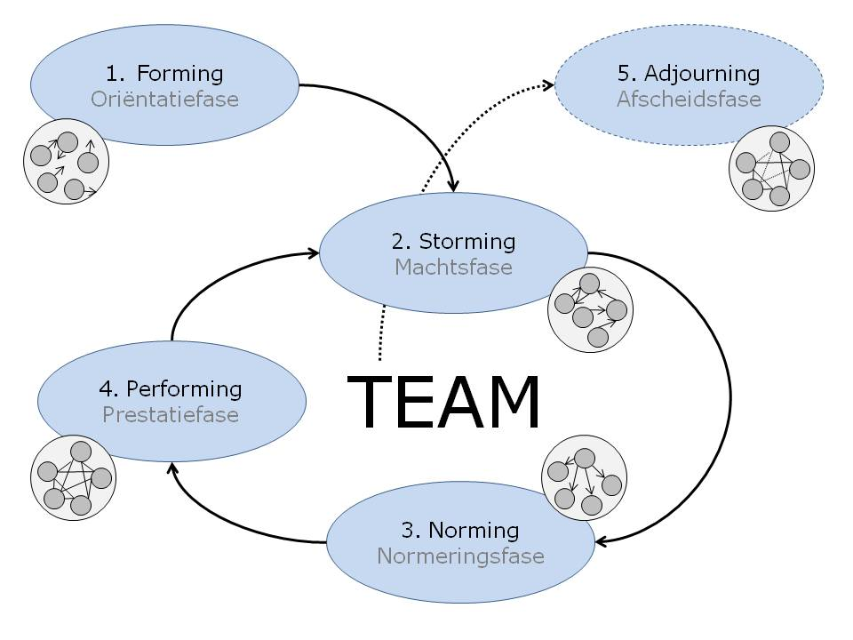
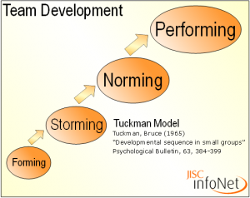
Forming, Storming, Norming, Performing Tuckman

Slide 40
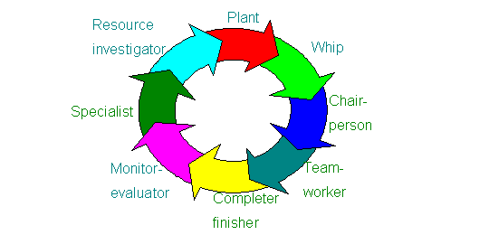
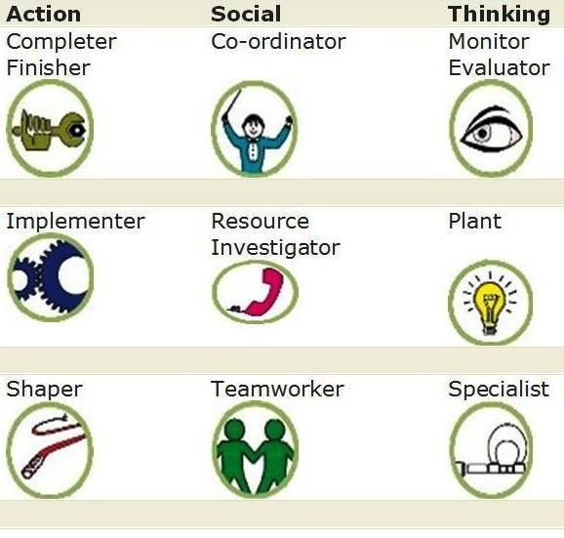
Teams: Belbin’s Team Role Inventories
Plant
Resource Investigator
Co-ordinator
Shaper
Monitor Evaluator
Teamworker
Implementer
Completer Finisher
Specialist
@todo: http://en.wikipedia.org/wiki/Belbin_Team_Inventory

Slide 41
Leading others

Slide 42
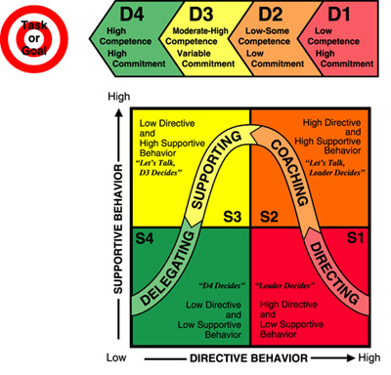
Leadership Style / Situational leadership theory
S1: Telling
is characterized by one-way communication in which the leader defines the roles of the individual or group and provides the what, how, why, when and where to do the task;
S2: Selling
while the leader is still providing the direction, he or she is now using two-way communication and providing the socio-emotional support that will allow the individual or group being influenced to buy into the process;
S3: Participating
this is how shared decision-making about aspects of how the task is accomplished and the leader is providing less task behaviours while maintaining high relationship behavior;
S4: Delegating
the leader is still involved in decisions; however, the process and responsibility has been passed to the individual or group. The leader stays involved to monitor progress.
http://en.wikipedia.org/wiki/Situational_leadership_theory

Slide 43
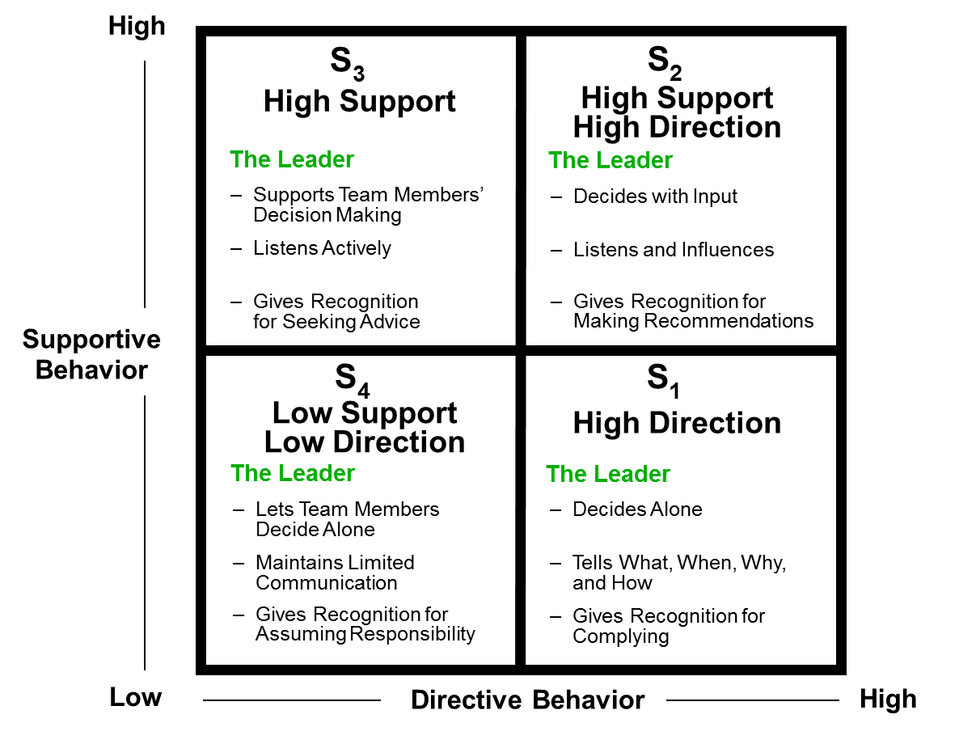
Leadership Styles
Notes:
In the ‘Leaders Window’ theory of John Beck, 4 leadership styles are identified. They can be explained over the axes of support and direction. S1 = Directive, S2 = Problem Solving, S3 = Developing (or coaching), S4 = Delegating. There is not one right style as the style that should be applied depends on the person you need to lead and to be more precise, the task the person needs to perform. For each task a person has a certain level of ability and motivation and based on this you need to determine how to lead.

Slide 44
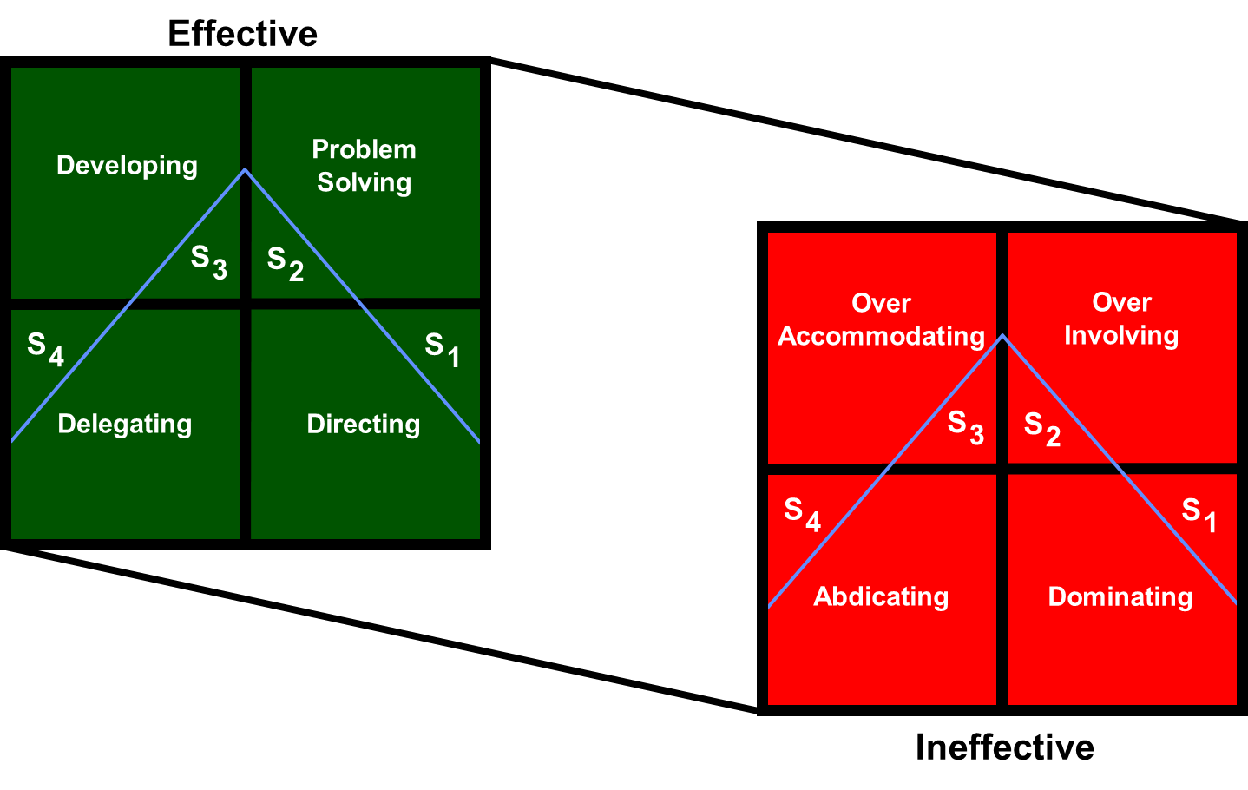
Style Effectiveness

Slide 45
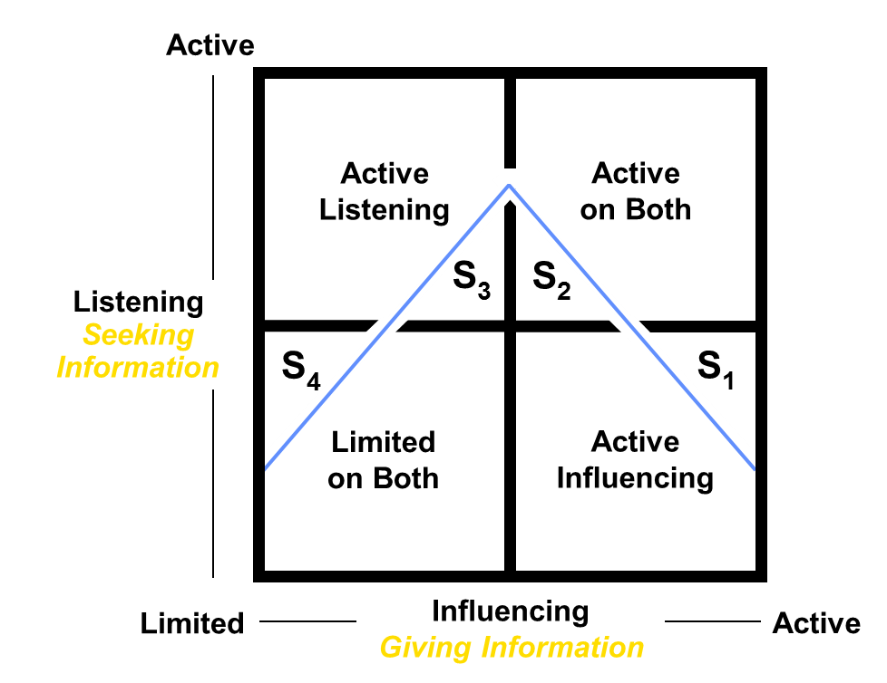
Leadership & Communication

Slide 46
Influencing & Listening
Giving Information
Directions
What
When
How
Advice
Suggestions
Explanations
Why
Consequences
Payoffs
Pitfalls
Feedback
Seeking Information
Paying Attention
Encouraging Openness
Verbal
Vocal
Non-Verbal
Asking Questions
Open
Closed
Reflecting Key Points
Paraphrasing Thoughts
Empathizing with Feelings
Summarizing

Slide 47
Personal Development
http://en.wikipedia.org/wiki/Category:Personal_development

Slide 48
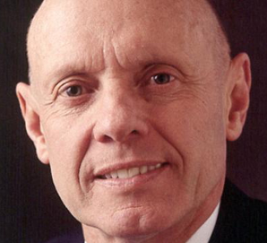
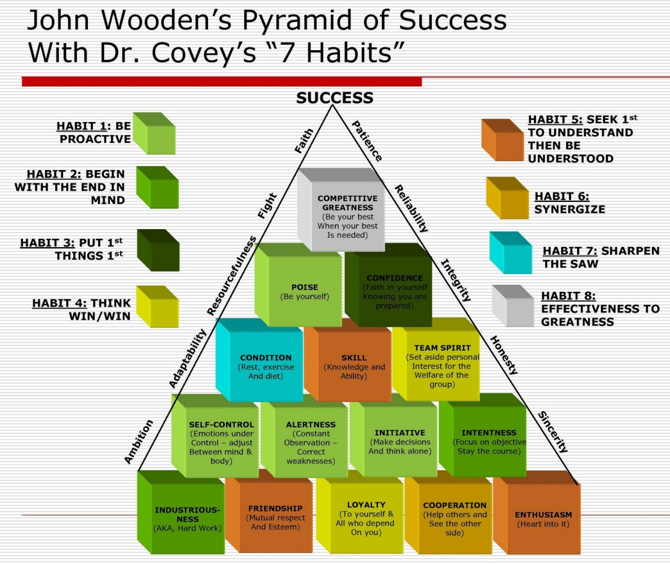
7 habbits of highly effective people Stephen R. Covey
Independence or Self-Mastery
Habit 1: Be Proactive
Habit 2: Begin with the End in Mind
Habit 3: Put First Things First
Interdependence
Habit 4: Think Win-Win
Habit 5: Seek First to Understand, Then to be Understood
Habit 6: Synergize
Change of attitude
Habit 7: Sharpen the Saw
http://en.wikipedia.org/wiki/The_Seven_Habits_of_Highly_Effective_People

Slide 49
Social Constructs

Slide 50
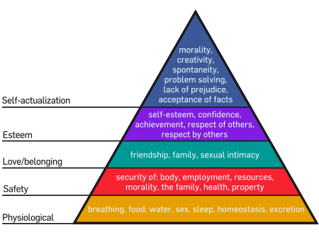
Maslow's hierarchy of needs is a theory in psychology proposed by Abraham Maslow in his 1943 paper "A Theory of Human Motivation" in Psychological Review.[2] Maslow subsequently extended the idea to include his observations of humans' innate curiosity
http://en.wikipedia.org/wiki/Maslow%27s_hierarchy_of_needs

Slide 51
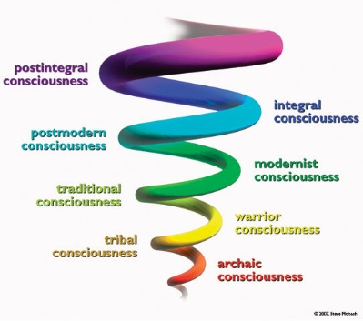
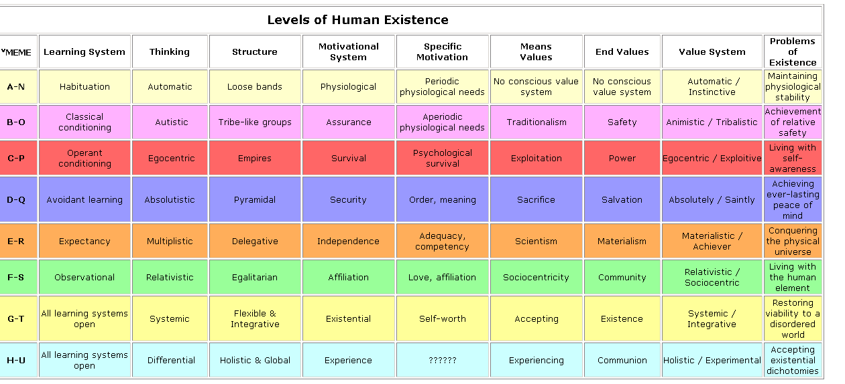
Spiral Dynamics: Value system
Notes:
http://spiraldynamicsintegral.nl/

Slide 52
Well being / work-life balance / etc

Slide 53
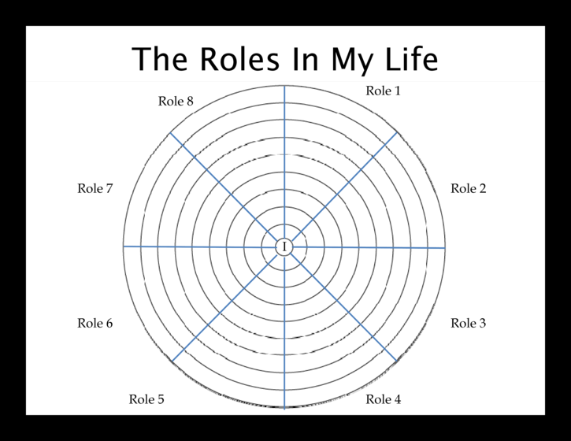
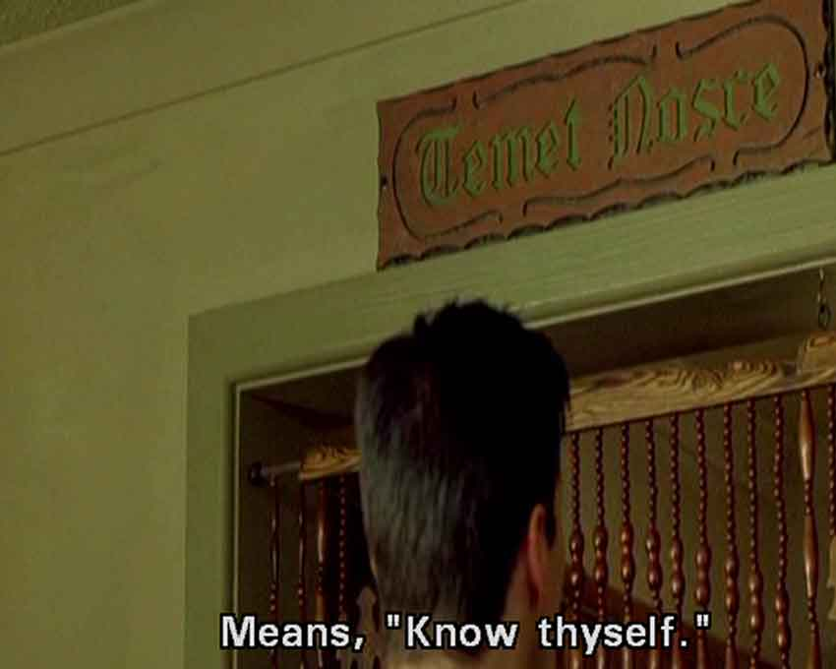
What roles in life do I have? Do I feel balanced? - know who you are
http://en.wikipedia.org/wiki/Know_thyself

Slide 54
Must I do this now? Setting priorities for yourself
Must I do this now?
Must I do this now?
Must I do this now?
Must I do this now?
Must I do this now?

Slide 55
Mindfulness – to control your focus/attention
Do not dwell in the past, do not dream of the future, concentrate the mind on the present moment – Buddha
It is not possible to think about ‘now’, only the past and future
Thinking about the past is only constructive to learn from it
Thinking about the future is only constructive for planning and risk gathering
Mindfulness refers to a psychological quality that involves
bringing one’s complete attention to the present experience on a moment-to-moment basis,
or involves
paying attention in a particular way: on purpose, in the present moment, and nonjudgmentally,
or involves
a kind of nonelaborative, nonjudgmental, present-centered awareness in which each thought, feeling, or sensation that arises in the attentional field is acknowledged and accepted as it is

Slide 56
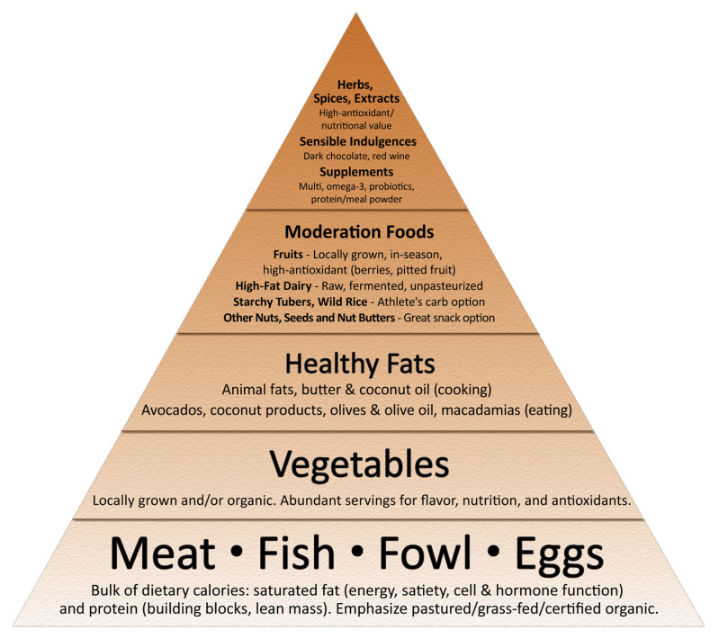
Take care of your body
What is the minimum your body needs?
Consume
Food
Fluids
Sleep
Exercise
http://www.marksdailyapple.com/
Primal Blueprint - Mark Sisson

Slide 57


Think – alternative routes
“We can not solve our problems with the same level of thinking that created them”
― Albert Einstein

Slide 58

Focus

